Slide 1






Exploring the Interconnectedness of GDP and Key Socioeconomic Factors
Piushani Ellegala
DATA 110

Slide 2
INTRODUCTION
Gross Domestic Product (GDP) serves as a crucial indicator of a country’s economic health, reflecting the total value of all goods and services produced over a specific time period.
Life expectancy is another vital metric, representing the average lifespan of individuals in a country and providing insight into the overall health and quality of life of its population.
This analysis aims to explore the relationships between GDP, life expectancy, and various other socioeconomic factors, using a comprehensive dataset that includes metrics from multiple countries.
The dataset contains 204 columns and 38 rows, encompassing a diverse range of economic and social indicators.
Data Source: https://www.kaggle.com/code/devraai/exploring-gdp-and-life-expectancy-relationships

Slide 3
Key Features of the Dataset
GDP: The total economic output of countries measured in current US dollars.
Sex Ratio: The ratio of males to females in the population.
Life Expectancy: The average lifespan for males and females.
Education Enrollment Rates: The percentage of the eligible population enrolled in educational institutions at various levels.
Unemployment Rate: The percentage of the labor force that is unemployed and actively seeking employment.
Homicide Rate: The number of homicides per 100,000 population, indicating levels of violence and safety.
Urban Population Growth: The annual growth rate of urban populations, reflecting urbanization trends.
CO₂ Emissions: The amount of carbon dioxide emissions per capita, serving as a measure of environmental impact.
Forested Area: The percentage of land area covered by forests, highlighting environmental sustainability.
Tourist Numbers: The total number of international visitors, indicating a country’s appeal as a tourist destination.

Slide 4
Data Cleaning
Handling Missing Values
Removed rows or columns with excessive missing values to maintain data integrity
Data Types
Verified correct data types for each variable (e.g., integers for counts, floats for continuous data) for accurate plotting and analysis.
Descriptive Statistics
Calculated key statistics (mean, median, min, max, standard deviation) for variables like GDP, life expectancy, and homicide rates to understand central tendencies and data spread.

Slide 5
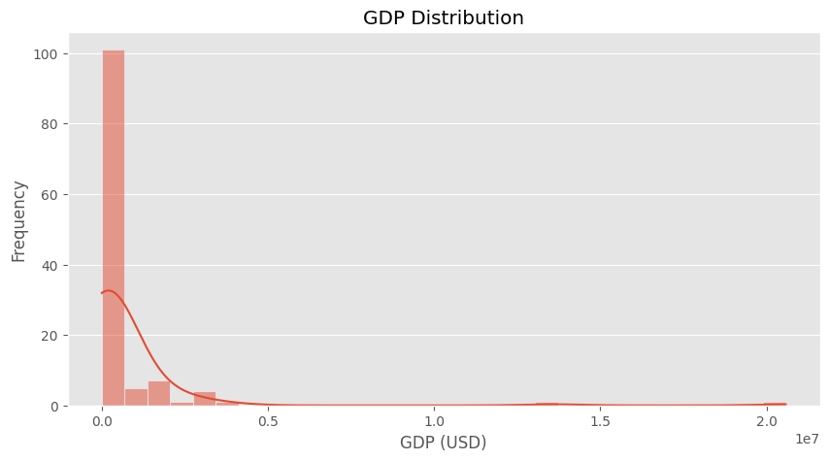
Histogram for GDP
Notes:
The histogram of GDP illustrates a right-skewed distribution, indicating that most countries have low to moderate GDP levels.
A few countries, such as the United States and China, have exceptionally high GDP figures, which raises the average GDP and highlights global economic inequality. This underscores the need for policies that foster equitable economic growth across nations.
This trend suggests a significant presence of developing countries, which often face challenges such as limited resources, high poverty rates, and economic instability.

Slide 6
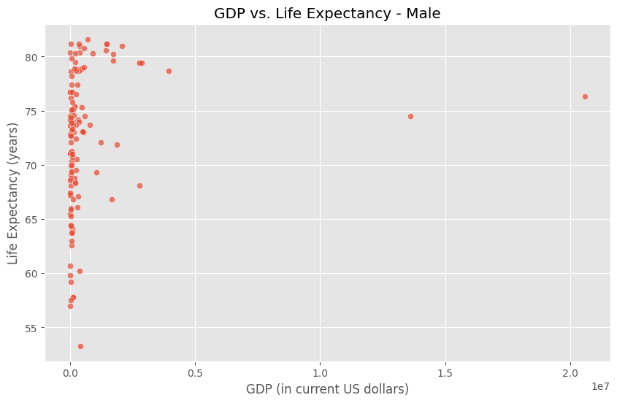
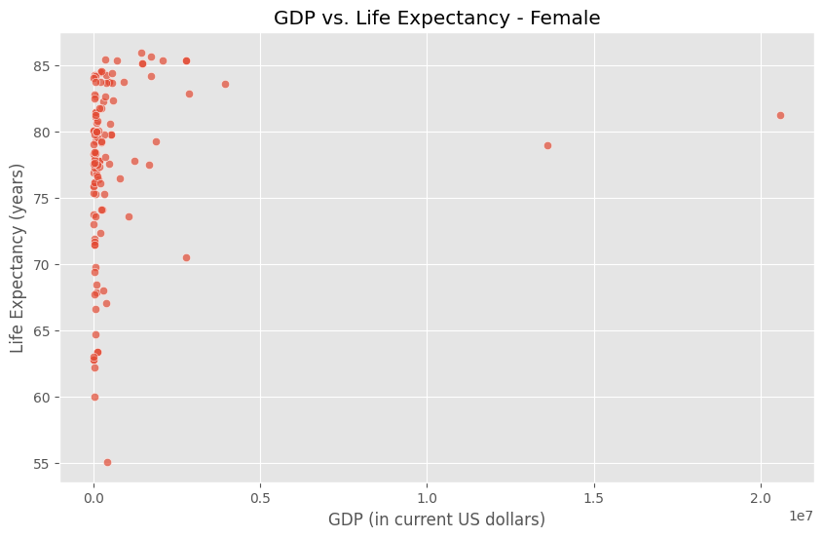
Scatter Plot of GDP vs. Life Expectancy
Notes:
Notably, many countries with low GDPs are clustered on the left side of the plot, indicating that they often experience economic difficulties that contribute to lower life expectancy rates.
This relationship emphasizes the urgent need for economic growth initiatives that prioritize healthcare improvements and access to essential services, particularly in low-income nations.
The scatter plot reveals a positive correlation between GDP and life expectancy, suggesting that countries with higher GDP tend to have longer life expectancies.

Slide 7
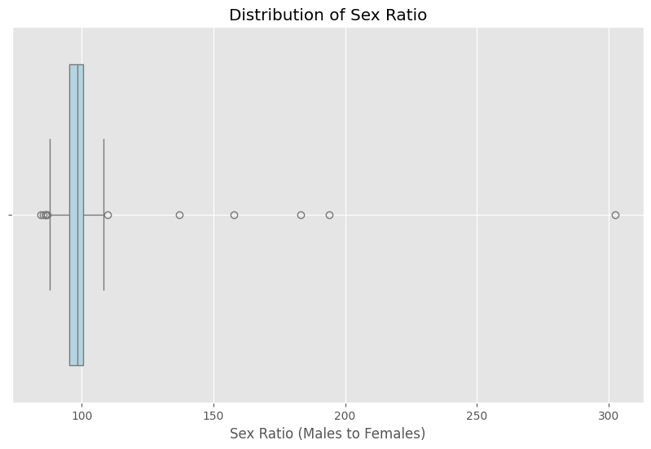
Sex Ratio Distribution
Notes:
The box plot depicting the sex ratio shows a right-skewed distribution, indicating that many countries tend to have more females than males or maintain a balanced ratio.
The majority of sex ratios are centered around 90 males for every 100 females, reflecting demographic trends that may influence social and economic policies.
Understanding these trends is crucial for developing gender-sensitive strategies that address disparities and promote gender equality in various aspects of life.

Slide 8
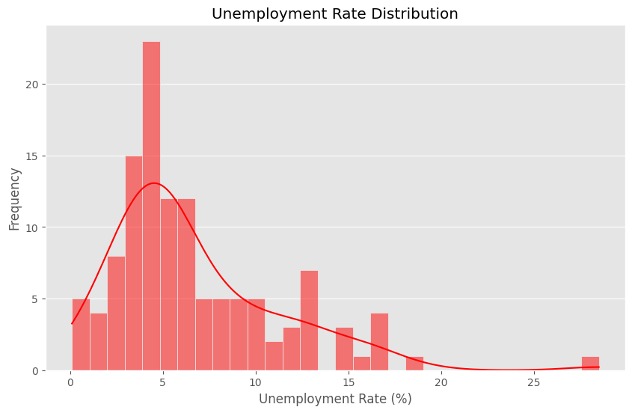
Unemployment Rate
Notes:
The histogram of unemployment rates reveals that most countries experience low unemployment, with a significant number clustering around 4%.
This distribution indicates relative economic stability in these nations, which can foster growth and development.
However, the presence of outliers with significantly higher unemployment rates signals ongoing economic challenges, highlighting the need for targeted interventions aimed at job creation and workforce development.

Slide 9
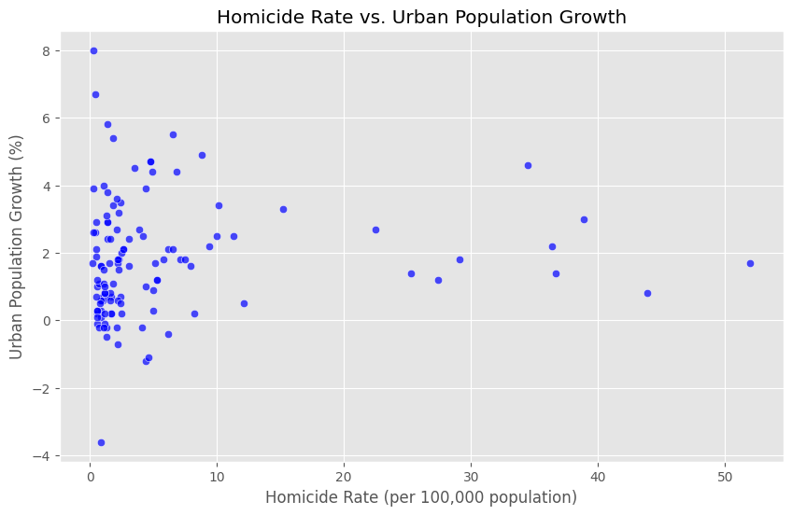
Homicide Rate vs. Urban Population Growth
Notes:
The scatter plot illustrates a positive correlation between lower homicide rates and healthy urban population growth.
Most countries with low homicide rates show strong urban development, suggesting that safety and security can enhance urbanization.
Conversely, regions with higher homicide rates exhibit varied urban growth rates, indicating that violence can significantly hinder consistent urbanization and economic progress.

Slide 10
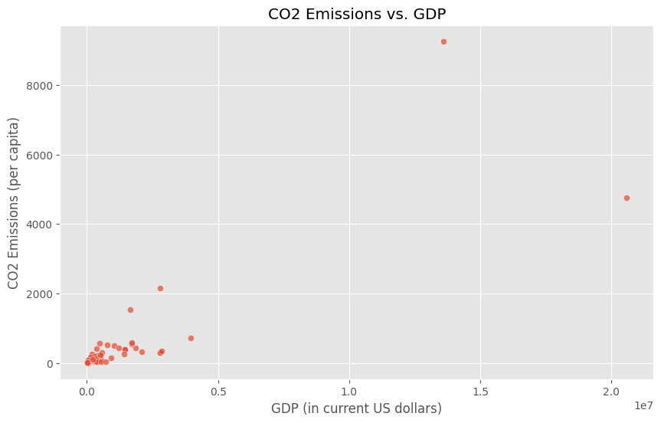
CO₂ Emissions vs. GDP
Notes:
The scatter plot demonstrates a positive correlation between GDP and CO₂ emissions, indicating that wealthier countries tend to have higher per capita emissions.
Notable outliers suggest that some countries achieve high emissions relative to their GDP, potentially due to heavy reliance on fossil fuels or specific industrial practices.
This relationship highlights the urgent need for sustainable practices that decouple economic growth from environmental degradation, emphasizing the importance of green technologies and renewable energy sources.

Slide 11
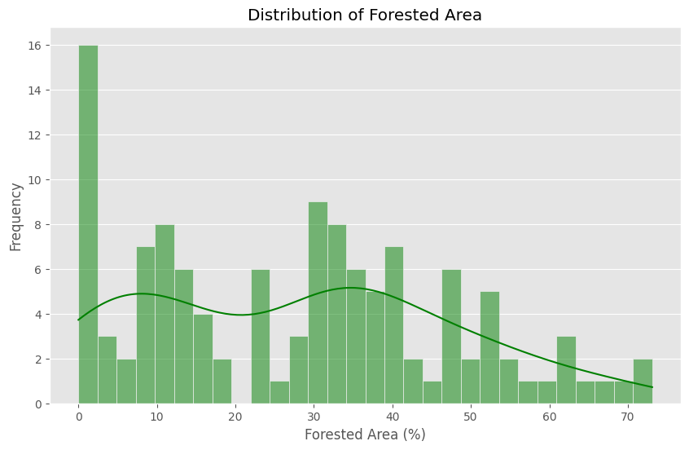
Forested Area
Notes:
The histogram of forested area shows a bimodal distribution, indicating that many countries have low percentages of forest cover.
This trend likely reflects challenges associated with urbanization, agricultural expansion, and deforestation.
The relatively few countries with higher percentages of forest cover suggest varying approaches to land use and environmental preservation, underscoring the need for sustainable development policies that prioritize forest conservation.

Slide 12
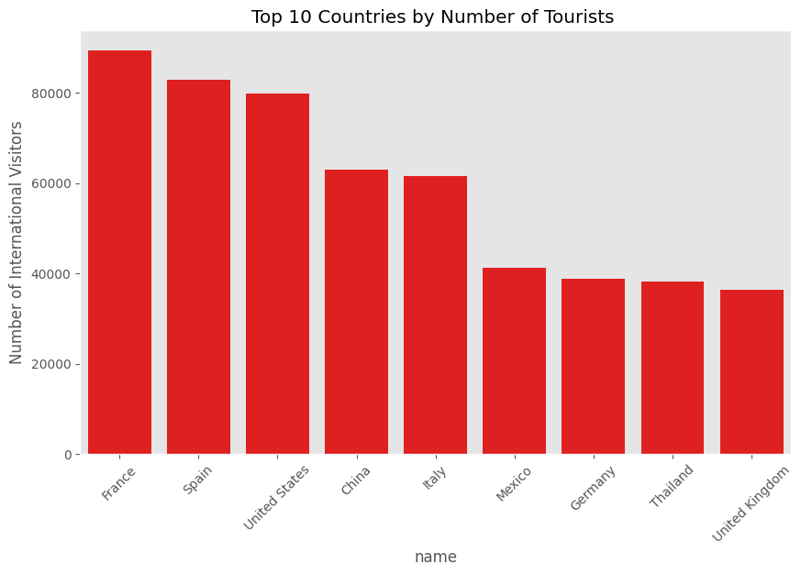
Tourist Numbers
Notes:
The bar plot highlights the top 10 countries based on the number of international tourists received annually.
France, Spain, and the United States consistently lead in attracting visitors, showcasing their tourism potential and the economic benefits that accompany high tourist numbers.
This data emphasizes the role of tourism as a significant driver of economic growth and the importance of maintaining attractive destinations to bolster national economies.

Slide 13
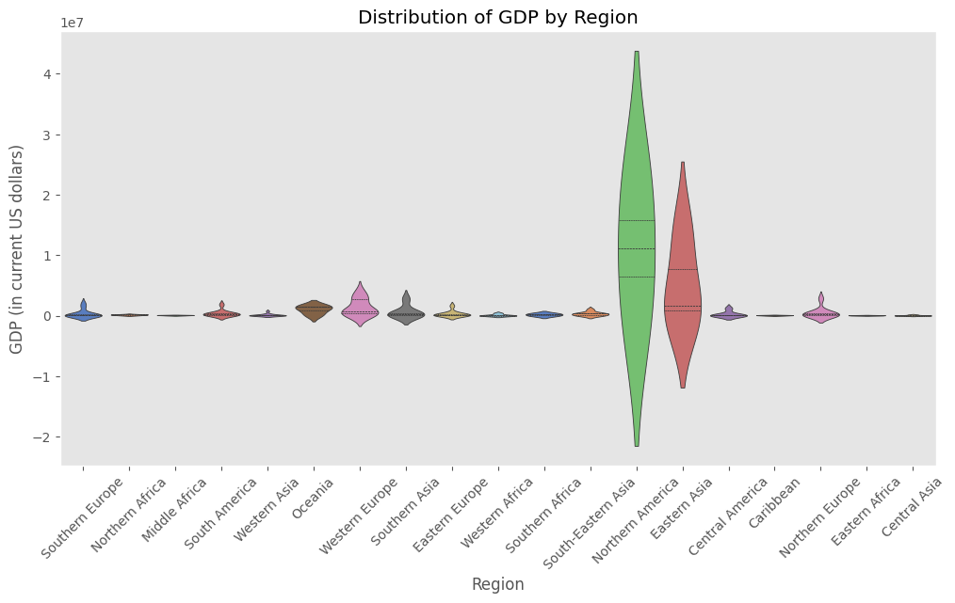
Violin Plot for GDP by Region
Notes:
The violin plot provides insights into GDP distribution across different regions, showcasing varying economic landscapes.
Regions such as Southeast Asia and Northern America exhibit considerable variation in GDP values, with wider spreads indicating significant disparities among countries.
This variation points to both challenges faced by lower-GDP countries and opportunities for growth in higher-GDP nations, emphasizing the need for region-specific economic policies.

Slide 14
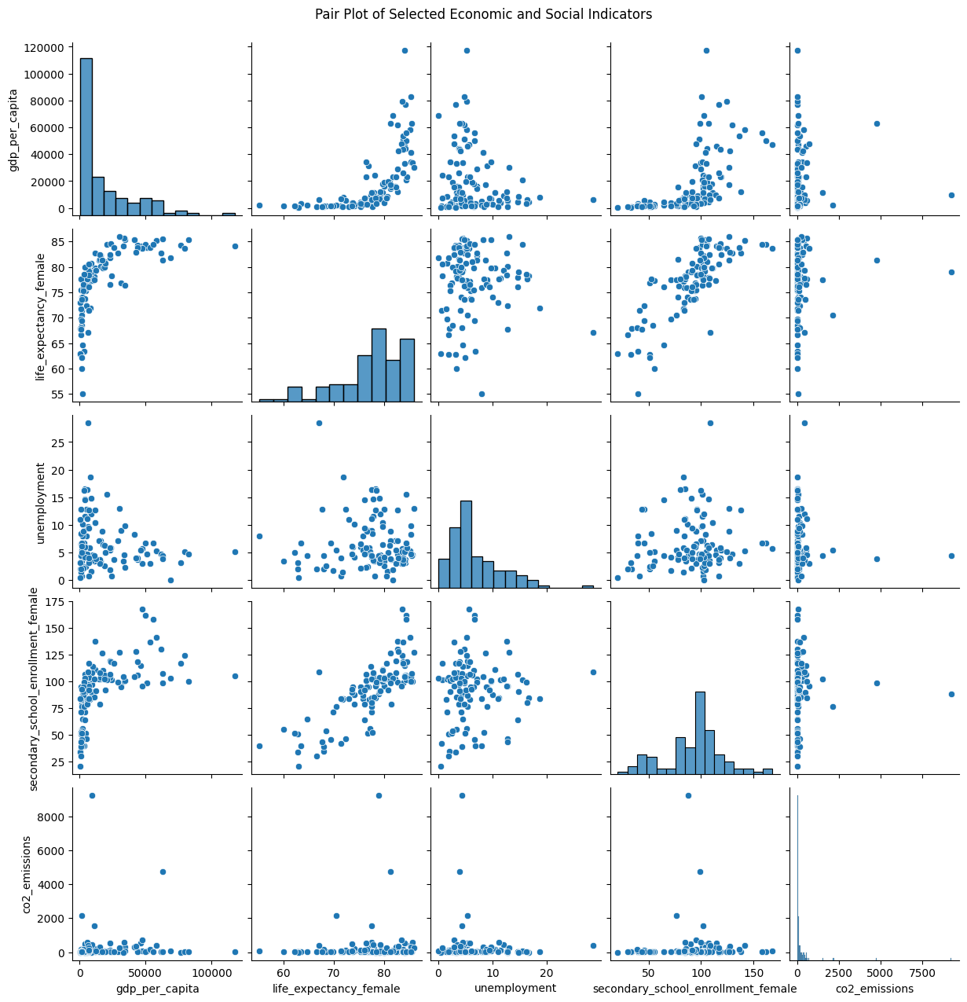
Pair plot
Notes:
The pair plot shows several relationships between economic and social factors. Countries with higher GDP per capita tend to have longer life expectancy for women and higher rates of girls in secondary school. This likely means that richer countries have better healthcare, living conditions, and education. There is also a slight link between high GDP and high CO2 emissions, which may be due to more industry and energy use. Unemployment doesn’t seem to affect life expectancy for women in a clear way. However, there is a positive link between girls’ school enrollment and life expectancy. It suggests that countries where more girls go to school also provide better healthcare.

Slide 15
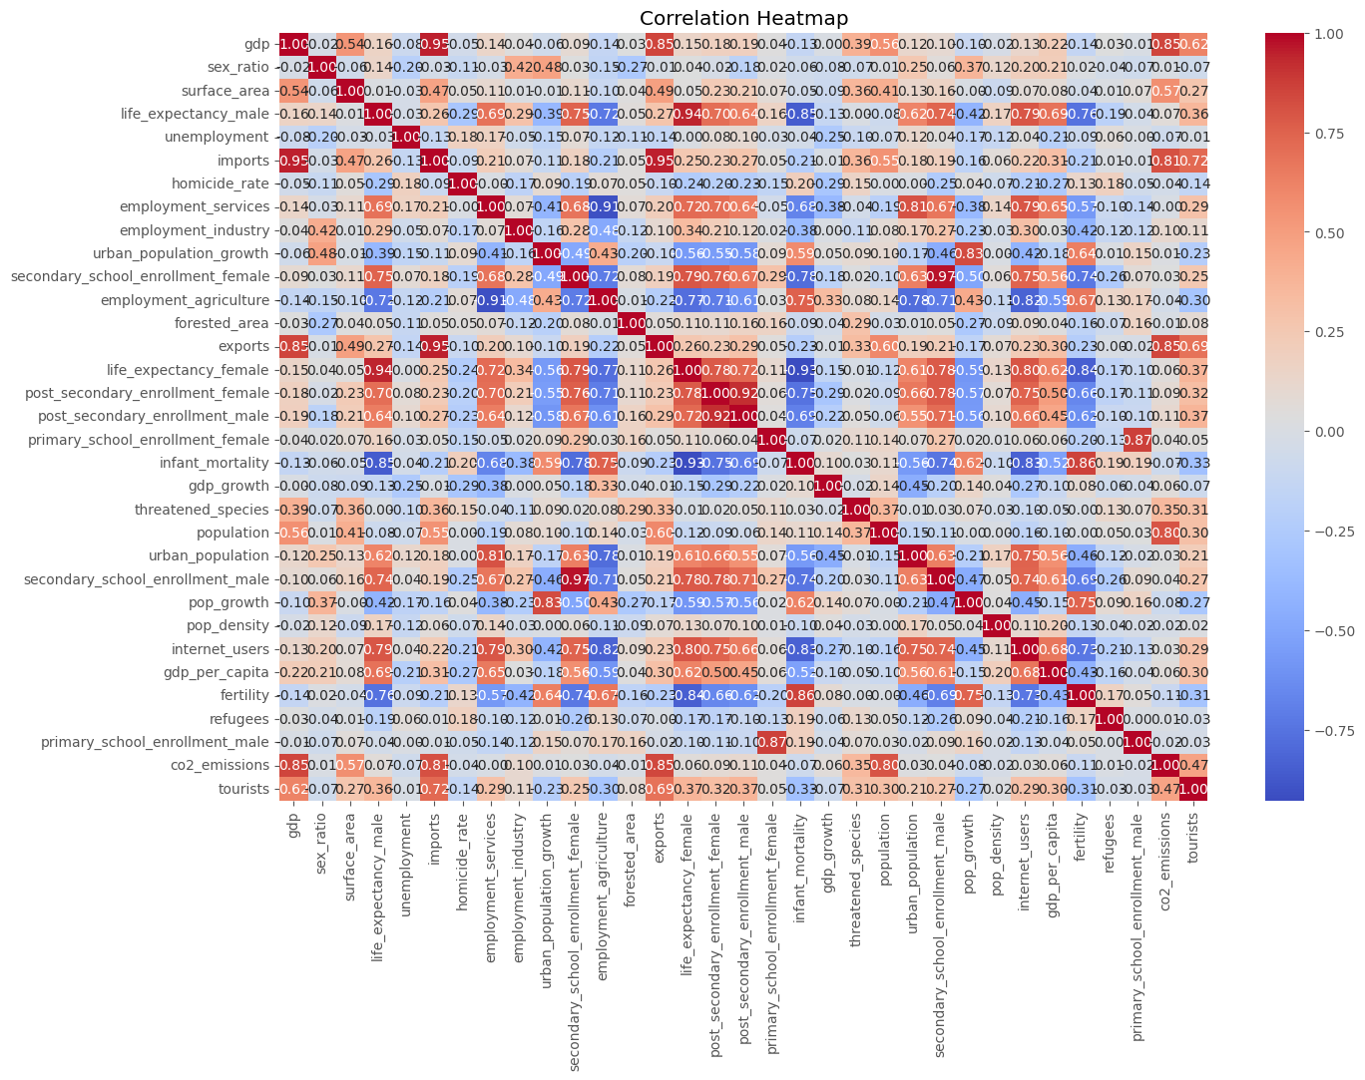
Heat Map

Slide 16
CONCLUSION
The analysis conducted has illuminated the intricate relationships between GDP and various socioeconomic indicators.
Overall, a higher GDP generally correlates with better life expectancy, highlighting the importance of economic development in improving health outcomes.
However, many developing countries face urgent economic challenges that require comprehensive approaches to foster growth and improve quality of life, emphasizing the need for targeted interventions and policies.

Slide 17
Recommendations
Policymakers should prioritize comprehensive economic strategies that address not only GDP growth but also healthcare access, education quality, and environmental sustainability.
Consider targeted initiatives to improve life expectancy and overall health outcomes in lower-GDP countries.
Further research should explore the role of education in mitigating unemployment and enhancing economic resilience across diverse regions.
Notes:
Policymakers should prioritize comprehensive economic strategies that address not only GDP growth but also healthcare access, education quality, and environmental sustainability.

Slide 18
Future Research Directions
Investigate the impact of specific policies aimed at improving life expectancy in lower-GDP countries and their effectiveness.
Explore the relationship between education levels and unemployment rates, analyzing how educational attainment can enhance job prospects.
Examine the relationship between tourism and economic growth in different regions, assessing how tourism can serve as a catalyst for broader economic development.

